Slide 1










AASD 4014 DEEP LEARNING I · FINAL PROJECT
91.97%
Data Quality-Recommender
BiGRU test accuracy on 7,600 unseen rows
A BiGRU and a denoising autoencoder that audit text data, and an agent that fixes it
91.3%
injected label flips found (ROC-AUC 0.975)
AG News
BiGRU
Autoencoder
Agent
Streamlit
86.2 → 99.6
Rithika Bhargav Khandavilli
Joao Marcos Gomes Da Silva
Sergey Molkov
James Tharian
data quality score after the agent

Slide 2



BACKGROUND
Background
Data
BiGRU
Detectors
Recommender
Agent
Wrap-up
Bad training data is found late and fixed by hand
Background and problem statement
The real-world situation
Objective
A news aggregator receives new labelled batches every week from scrapers, partners and annotators
Batches contain missing fields, 'N/A' placeholders, duplicated wire stories and broken HTML
Wrong labels and junk rows (gibberish, code, product listings) cannot be caught with rules
Today these are found by hand, often only after a model behaves strangely
Given any CSV of labelled text: detect the quality issues, score them, recommend an ordered preprocessing plan, and let an agent apply and verify the fixes.
Success criteria
Classifier good enough to audit labels (> 90% test accuracy)
High recall on issues we inject ourselves (known ground truth)
Cleaning must improve a model trained on the data
Course option 1 (RNN models on text, trained and evaluated) plus an option 2 element (an agent solving a real task)
DQ-Recommender · AASD 4014 Deep Learning I
⌂ Home
2/25

Slide 3

BACKGROUND
Background
Data
BiGRU
Detectors
Recommender
Agent
Wrap-up
Plan of attack
Data first, then two models from scratch, then measure the whole system on known problems
1
2
3
4
5
6
EDA + audit
Preprocess
Train models
Tune + evaluate
Recommender
Agent + app
balance, correlation, hidden issues
repair, dedupe, leakage, outliers, vocab
BiGRU + char autoencoder
grid search, curves, confusion
issues, severity, score, plan
apply, verify, Streamlit
How each layer is evaluated
Classifier
Detectors
Agent
accuracy, macro-F1, confusion matrix on the untouched 7,600-row test set, against a TF-IDF benchmark
recall, precision and ROC-AUC on a test copy with 14 kinds of injected issues
retrain the same model on the data before and after; score on 5,000 independent clean rows
DQ-Recommender · AASD 4014 Deep Learning I
⌂ Home
3/25

Slide 4


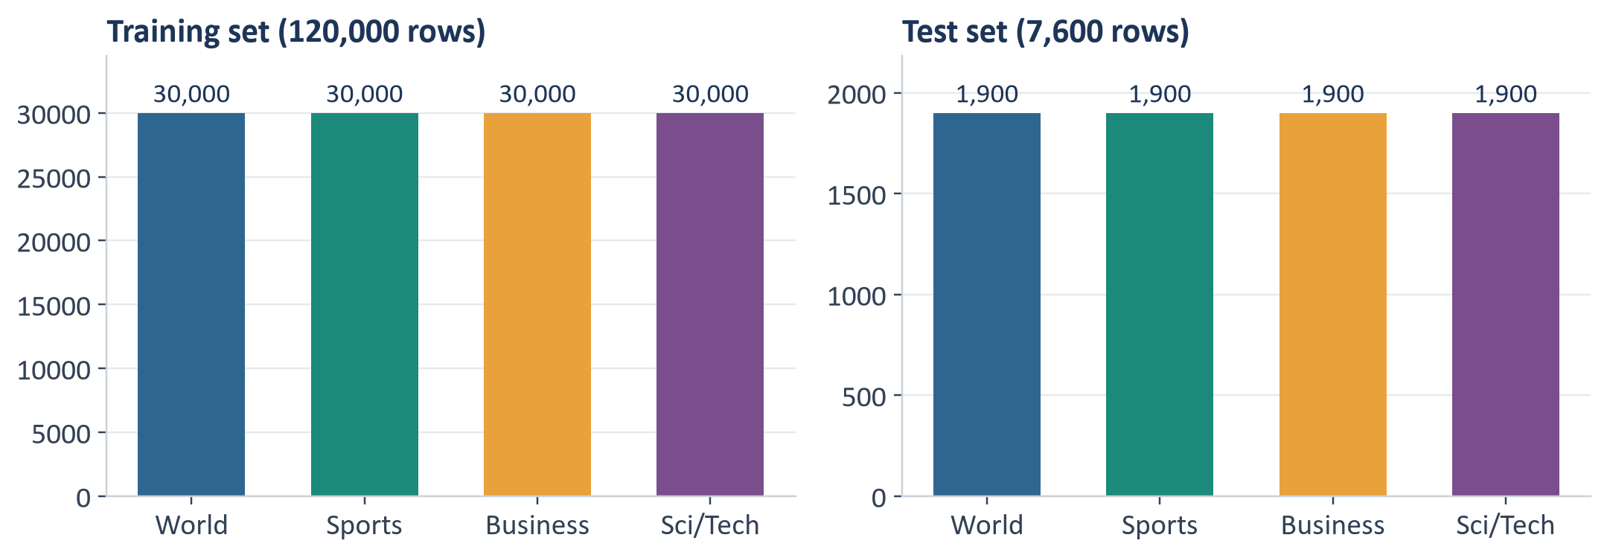
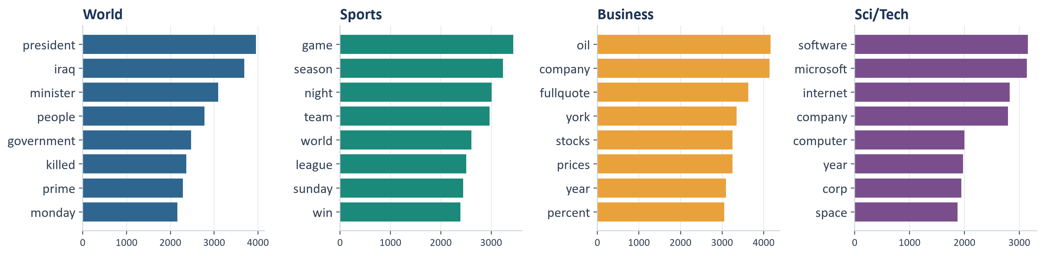
DATA
Background
Data
BiGRU
Detectors
Recommender
Agent
Wrap-up
The dataset: AG News
127,600 news snippets, 4 topics, Kaggle: amananandrai/ag-news-classification-dataset
120,000
7,600
training rows
test rows
1 : 1
38
class ratio, no imbalance
words per row on average
Imbalance: none in AG News, so no resampling. The recommender still measures it (imbalance ratio, normalised entropy) and suggests class weights for uploaded data.
Columns: Class Index (1 World, 2 Sports, 3 Business, 4 Sci/Tech), Title, Description
DQ-Recommender · AASD 4014 Deep Learning I
⌂ Home
4/25

Slide 5

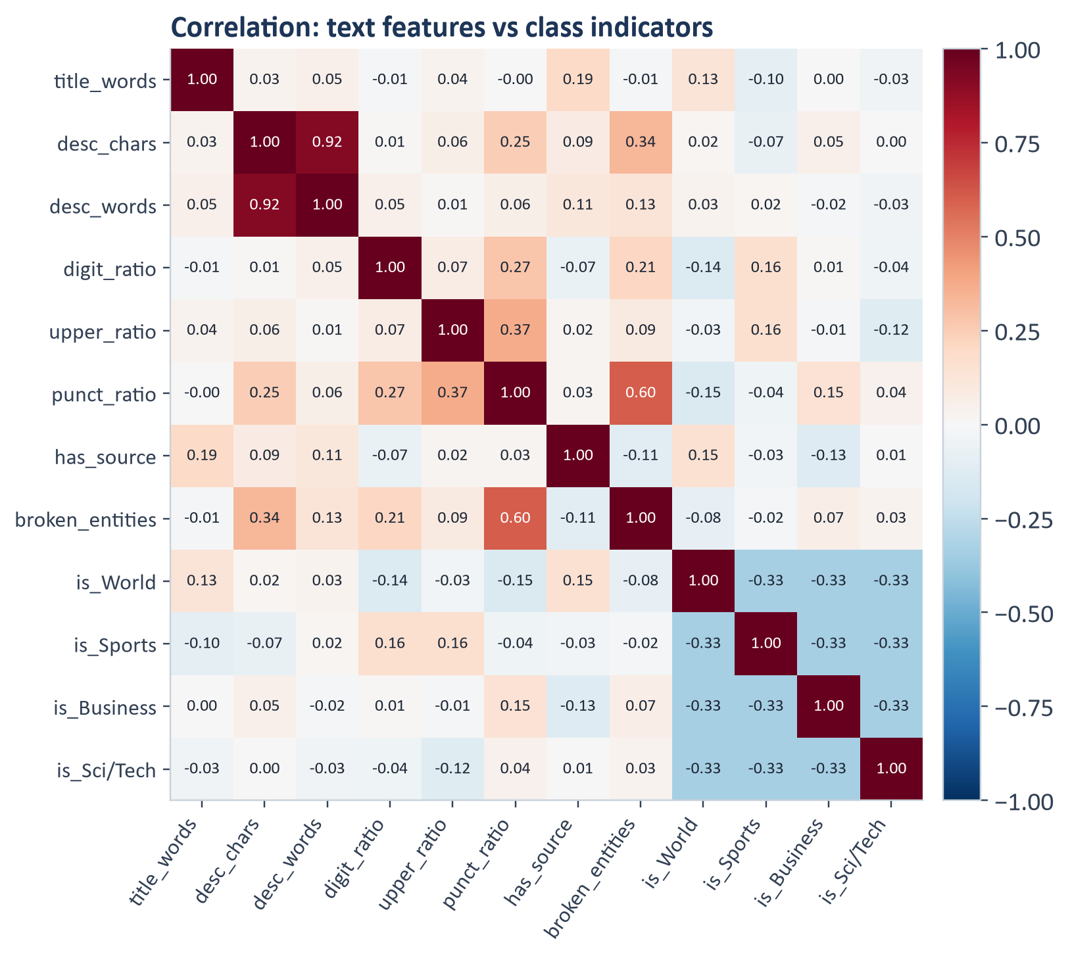
DATA
Background
Data
BiGRU
Detectors
Recommender
Agent
Wrap-up
EDA: correlation says we need a model of the words
What the heatmap shows
desc_chars vs desc_words r = 0.92: redundant, keep one
Class links are weak (|r| ≤ 0.16): digits and capitals lean Sports, a source prefix leans World
broken_entities vs punct_ratio r = 0.60: HTML debris inflates punctuation, a data quality signal
Source prefix (Reuters, AP, AFP) in 16% of rows leans to some classes: a mild shortcut risk
Topic is not decided by length or formatting, which motivated a recurrent model over learned word embeddings
DQ-Recommender · AASD 4014 Deep Learning I
⌂ Home
5/25

Slide 6
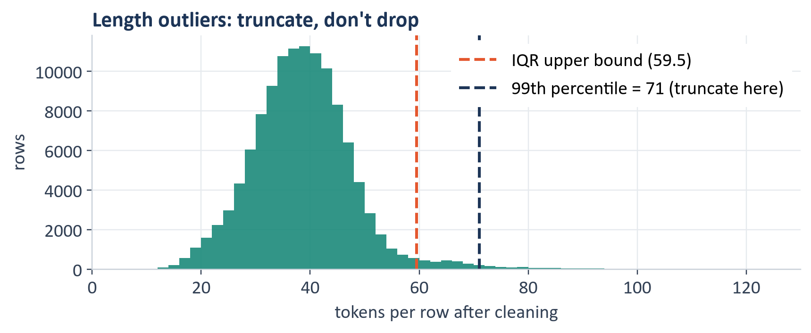
DATA
Background
Data
BiGRU
Detectors
Recommender
Agent
Wrap-up
AG News looks clean, but it is not
No NaN and perfectly balanced, yet a manual audit finds real problems
Issue found | Rows | What we did
Broken HTML entities (#39;, quot;) | 29,132 | Repair, unescape twice, NFKC
Escaped tags / backslashes | 2,675 / 12,522 | Strip tags, replace backslashes
Same text, conflicting labels | 105 | Drop the group
Duplicate texts | 264 | Keep the first copy
Train rows also in test (leakage) | 32 | Remove from training
Longer than IQR bound (59.5 tokens) | 3,320 | Truncate at 71 (99th pct)
Fewer than 5 tokens ('#NAME?') | 1 | Drop
Outliers: long rows are real news, so we truncate at 71 tokens (0.96% of rows) instead of dropping. 30,000 words cover 98.7% of tokens; the bag-of-words matrix is 99.95% zeros, so we use dense learned embeddings.
119,598 clean rows → 107,638 train / 11,960 validation (stratified); 7,600 test rows untouched
DQ-Recommender · AASD 4014 Deep Learning I
⌂ Home
6/25

Slide 7


BIGRU
Background
Data
BiGRU
Detectors
Recommender
Agent
Wrap-up
Methods at a glance: how the pieces fit
Two networks feed a recommender; the agent acts on its report
Statistical profiler
missing, dups, conflicts, sparsity, outliers
CSV of labelled text
BiGRU classifier
Recommender
Preprocessing agent
any upload
p(class | text) → label auditor
issues, severity, 0-100 score, plan
observe → plan → act → verify
Char autoencoder
re-audits after every step and rolls back if the score drops
reconstruction error → anomaly z
BiGRU deep dive →
Autoencoder deep dive →
Agent deep dive →
Both networks are trained from scratch in PyTorch; the recommender and agent reuse them through one shared package (dq/)
DQ-Recommender · AASD 4014 Deep Learning I
⌂ Home
7/25

Slide 8

BIGRU
Background
Data
BiGRU
Detectors
Recommender
Agent
Wrap-up
BiGRU classifier: architecture and tensor shapes
Embedding → bidirectional GRU → masked max + mean pooling → regularised MLP head
Token ids
Embedding
BiGRU
Max ⊕ mean pool
BN · Drop · Dense
BN · Drop · Dense
B × 71
B × 71 × 200
B × 71 × 256
B × 512
B × 128
B × 4
30k vocab, pad = 0
6.0 M params, dropout 0.15
128 units each way
padding masked out
ReLU, dropout 0.3
logits → softmax
Layer | Parameters | How
Embedding 30,000 × 200 | 6,000,000 | V × E
BiGRU (2 directions) | 253,440 | 2 × 3H(E + H + 2)
BatchNorm 512 + 128 | 1,280 | 2 × features
Linear 512 → 128 | 65,664 | 512·128 + 128
Linear 128 → 4 | 516 | 128·4 + 4
Total | 6,320,900 | 95% in the embedding
Why this design
GRU over LSTM: 2 gates instead of 3, 25% fewer recurrent weights, same accuracy on short texts
Bidirectional: every position sees left and right context ('shares fell' vs 'fell to rebels')
Max + mean pooling: strongest topic cue plus a whole-text summary
DQ-Recommender · AASD 4014 Deep Learning I
⌂ Home
8/25

Slide 9

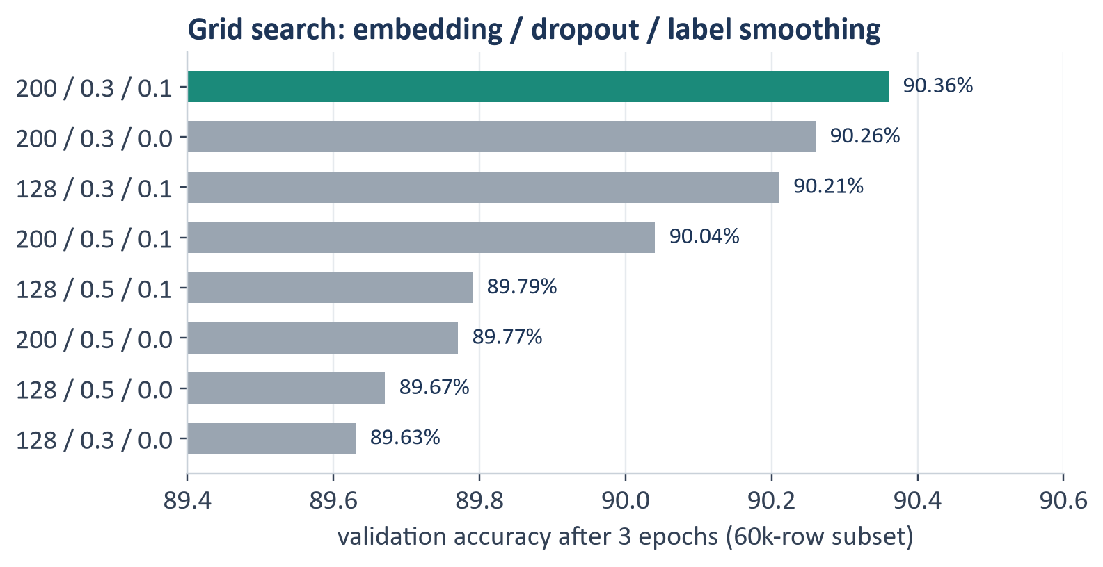
BIGRU
Background
Data
BiGRU
Detectors
Recommender
Agent
Wrap-up
Hyperparameter tuning
2 × 2 × 2 grid: embedding size, dropout, label smoothing (3 epochs on 60k rows, full validation set)
How the model changed
Embedding 200 > 128 in all 4 pairs: more capacity for rare words
Label smoothing 0.1 helped in 3 of 4: softer targets, better-calibrated probabilities
Dropout 0.3 > 0.5 in 3 of 4: 0.5 underfits in a short run
Spread only 0.7 points: architecture matters more than these settings
Selected: embedding 200, dropout 0.3, label smoothing 0.1, hidden 128, learning rate 2e-3
DQ-Recommender · AASD 4014 Deep Learning I
⌂ Home
9/25

Slide 10

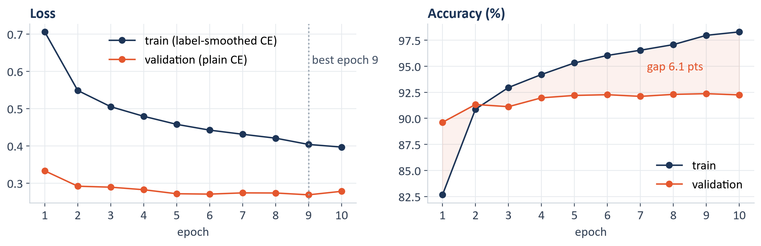
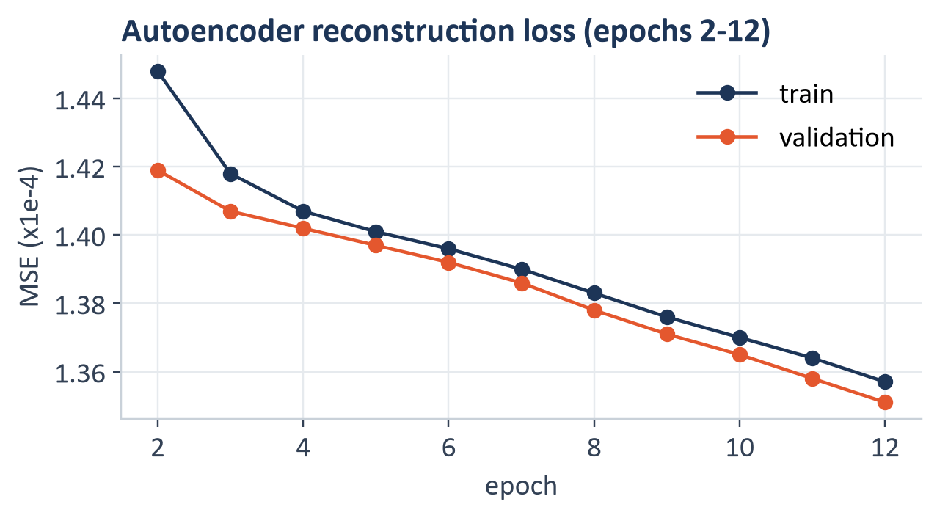
BIGRU
Background
Data
BiGRU
Detectors
Recommender
Agent
Wrap-up
Training: is the model overfitting?
Verdict
Mild overfit: train 98.3% vs validation 92.3%
Contained: validation loss flat; early stopping keeps epoch 9
Train loss > validation loss because of label smoothing and dropout in training
Autoencoder: train and validation fall together
10 epochs in 142 s on an RTX 3050 Laptop GPU (4 GB), peak 1.3 GB VRAM. Losses and accuracies also logged to TensorBoard.
Dropout, BatchNorm, label smoothing and weight decay keep validation stable while training accuracy climbs
DQ-Recommender · AASD 4014 Deep Learning I
⌂ Home
10/25

Slide 11

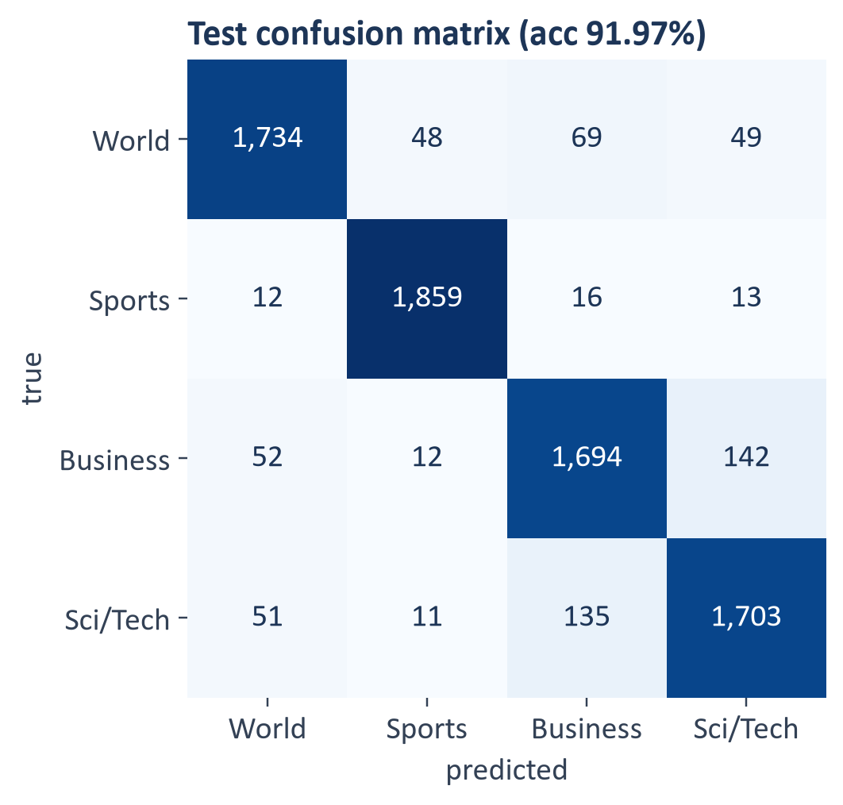
BIGRU
Background
Data
BiGRU
Detectors
Recommender
Agent
Wrap-up
Evaluation on the untouched test set
91.97%
0.920
92.32%
test accuracy
macro-F1
TF-IDF + LR baseline
Class | F1 | Main confusion
World | 0.925 | Business (69)
Sports | 0.971 | easiest class
Business | 0.888 | Sci/Tech (142)
Sci/Tech | 0.895 | Business (135)
The baseline wins by 0.35 points: short news has strong keyword cues. The BiGRU earns its place as a calibrated label auditor (ECE 0.040).
Business and Sci/Tech overlap (Apple, Google, mergers), which is also where the auditor finds genuine ambiguity
DQ-Recommender · AASD 4014 Deep Learning I
⌂ Home
11/25

Slide 12

BIGRU
Background
Data
BiGRU
Detectors
Recommender
Agent
Wrap-up
BiGRU predictions on example inputs
predict() on sentences we wrote and on random unseen test rows
Input | Predicted | Prob. | True label
Stocks rallied after the Fed left interest rates unchanged | Business | 0.92 | own example
The Lakers beat the Celtics 112-104 behind a late run | Sports | 0.68 | own example
Researchers unveiled a chip that doubles battery life | Sci/Tech | 0.84 | own example
Peace talks resumed in Geneva as the UN pressed both sides | World | 0.97 | own example
Apple shares fell after weaker iPhone sales | Business (Sci/Tech 0.34) | 0.50 | own example
Retailers Vie for Back-To-School Buyers (Reuters) | Business | 0.86 | Business
Motorola buy adds heat to mesh networking | Sci/Tech | 0.88 | Sci/Tech
Steel group sees continued strength in China demand | Business | 0.96 | Business
Iraq's Neighbors to Get Little for Environment Loss (Reute | Business | 0.40 | Sci/Tech
Hughes allowed to speak to Rovers | Sports | 0.93 | Sports
D.C. to Face K.C. for MLS Championship (AP) | Sports | 0.94 | Sports
Yanks beat Pedro again; Santana wins 20th | Sports | 0.90 | Sports
UN Signs Pact with New World Court Opposed by U.S. | World | 0.85 | World
Reading the outputs
Clear topics: 0.84 to 0.97 confidence
Ambiguous: Apple sales splits Business 0.50 / Sci/Tech 0.34
The one miss (Iraq environment story) has only 0.40 confidence
Confidence tracks correctness (ECE 0.040), which the label auditor relies on
Wrong or uncertain predictions come with low confidence, so only confident disagreements are flagged as label errors
DQ-Recommender · AASD 4014 Deep Learning I
⌂ Home
12/25

Slide 13


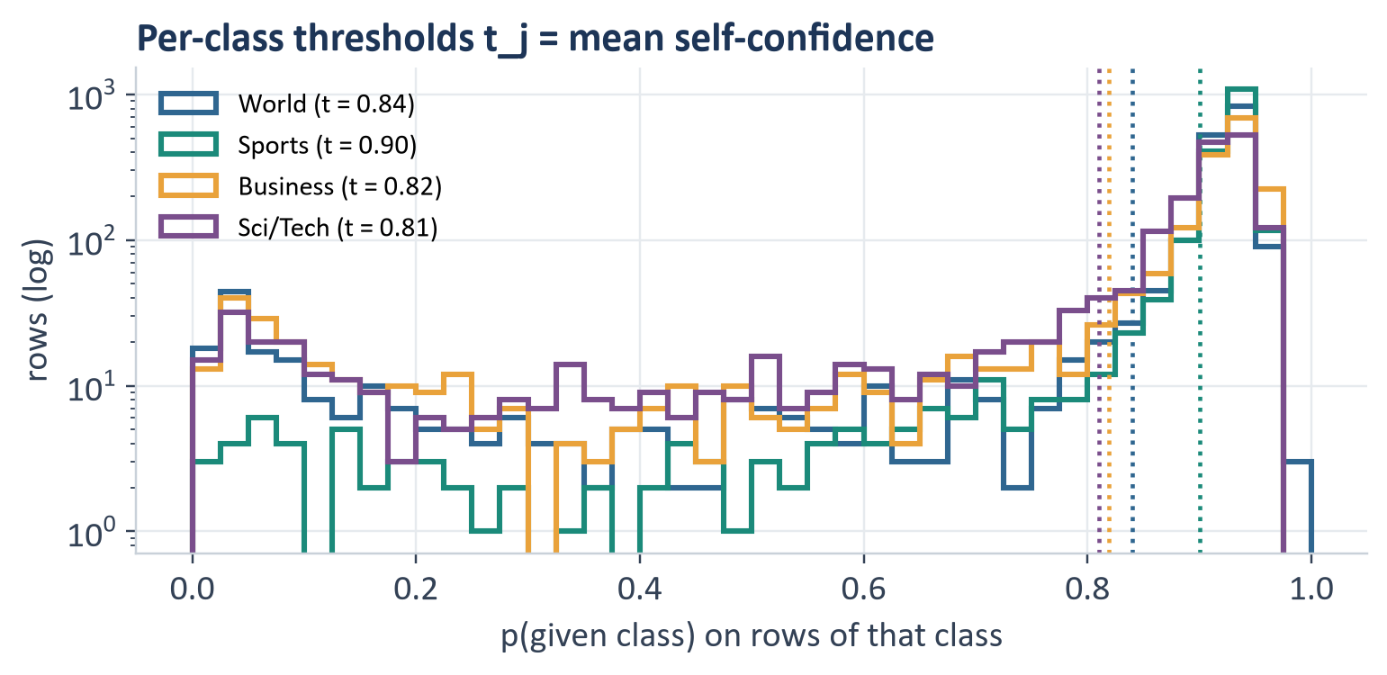
DETECTORS
Background
Data
BiGRU
Detectors
Recommender
Agent
Wrap-up
Turning the classifier into a label auditor
Confident learning with per-class thresholds
Decision rule
t_{j} = mean { p_{j}(x) : label(x) = j }
flag x ⇔ ∃ k ≠ y : p_{k}(x) ≥ t_{k}
suggested = argmax_{k ≠ y} p_{k} (among k with p_{k} ≥ t_{k})
rank by margin = p_{suggested} − p_{y}
Rows with fewer than 12 tokens are skipped: too little text to judge.
0.90
0.81
0.975
261
threshold for Sports (most confident class)
threshold for Sci/Tech (least confident)
ROC-AUC on injected label flips
suspect rows in the real AG News test set (3.4%)
DQ-Recommender · AASD 4014 Deep Learning I
⌂ Home
13/25

Slide 14

DETECTORS
Background
Data
BiGRU
Detectors
Recommender
Agent
Wrap-up
Denoising character autoencoder: architecture
Learns what normal news text looks like at the character level
Char 2-4 grams
Input dropout
Reconstruction
Encoder
Decoder
Bottleneck
4,096
4,096
512
64
512
4,096
hashing trick, L2 norm
10% noise (denoising)
Linear · BN · ReLU · Drop 0.2
Linear · BN · ReLU
Linear · ReLU
Linear (no activation)
Objective
Why character n-grams? | Parameters
Gibberish made of unknown words gives a word model an all-<unk> input: no signal | Encoder 2,131,648
n-grams always exist, and random or misspelled text produces n-grams news rarely has | Decoder 2,134,528
Hashing needs no vocabulary to fit or ship; the app rebuilds it identically | Total 4,266,176
x̃ = dropout(x, 0.1)
L = (1/d) ‖ g(f(x̃)) − x ‖², d = 4,096
Scoring →
DQ-Recommender · AASD 4014 Deep Learning I
⌂ Home
14/25

Slide 15
DETECTORS
Background
Data
BiGRU
Detectors
Recommender
Agent
Wrap-up
Autoencoder: features and training
From raw text to a 4,096-dimensional character profile, learned only from clean news
1 Raw text
2 char_wb 2-4 grams
3 Hash into buckets
4 Input vector x
"Oil hits record high"
o
oi
il
oil
bucket = hash(n-gram) mod 4,096
no vocabulary to fit or ship
x ∈ ℝ⁴⁰⁹⁶, ‖x‖ = 1
≈ 388 active buckets per row
il
hi
hit
its
re
rec
ord
hig
Training setup
Input | z | Flag
Real news sentence | -1.66 | no
Short headline | 0.65 | no
Heavy typos | -0.24 | OOV rule
Random characters | 3.65 | yes
Python code | 2.59 | yes
Product listing | 2.98 | yes
107,638 cleaned training texts only
Adam, lr 1e-3, batch 512, 12 epochs
10% input dropout, MSE reconstruction loss
47 s on the GPU, 0.28 GB peak memory
Sparse rows densified one batch at a time
DQ-Recommender · AASD 4014 Deep Learning I
⌂ Home
15/25

Slide 16

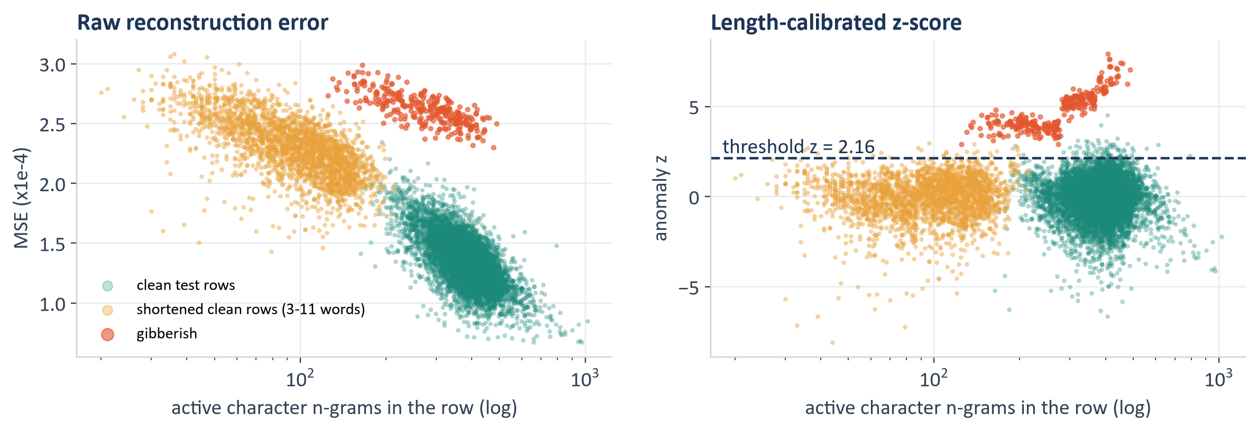
DETECTORS
Background
Data
BiGRU
Detectors
Recommender
Agent
Wrap-up
Autoencoder: a fair, length-calibrated anomaly score
Our first version flagged short normal texts; length calibration fixed it
Length-calibrated score
e = (1/d) ‖x̂ − x‖²
b = bin of the active n-gram count (20 bins)
z = (log e − median_{b}) / (1.4826 · MAD_{b})
flag ⇔ z > 2.16 (99th pct of clean)
95.7%
1.1%
100%
0.983
short clean rows flagged by one raw threshold
short clean rows flagged after calibration
gibberish flagged (with the OOV > 30% rule)
ROC-AUC on junk rows in the benchmark
← Architecture
DQ-Recommender · AASD 4014 Deep Learning I
⌂ Home
16/25

Slide 17





RECOMMENDER
Background
Data
BiGRU
Detectors
Recommender
Agent
Wrap-up
The recommender: from findings to an ordered plan
Every finding becomes a scored, explained issue with a fix and a place in the pipeline
Profiler
missing, duplicates, conflicts, sparsity, outliers
Issue engine
Quality score
Plan + report
BiGRU auditor
confident-learning label noise
category, severity, rows, why, fix, code
5 dimensions → 0-100, grade A-F
HTML / Markdown, issues CSV, preprocess.py
Autoencoder + OOV
garbled and off-domain rows
Severity | Share of rows affected
critical | ≥ 20%
high | ≥ 5%
medium | ≥ 1%
low | < 1%
info | advice only
Dimension | Score = 100 − | Weight
Completeness | % missing cells | 0.30
Uniqueness | % duplicate + % near-duplicate rows | 0.20
Validity | ½ % artifacts + % junk/short + ½ % outliers | 0.30
Label quality | 2 × % bad-label rows | 0.25
Balance | 100 × normalised entropy | 0.10
Plan order (step 0 to 11)
standardise missing → drop ID columns → empty / invalid labels → repair text → duplicates and conflicts → near duplicates → short / junk rows → vocabulary → sequence length, outliers → scaling → class imbalance → label noise
Overall = Σ w·s / Σ w over the 5 dimensions; A ≥ 90, B ≥ 80, C ≥ 70. Weights renormalise when there is no label column
DQ-Recommender · AASD 4014 Deep Learning I
⌂ Home
17/25

Slide 18

RECOMMENDER
Background
Data
BiGRU
Detectors
Recommender
Agent
Wrap-up
Benchmark: injecting problems we can measure
Unseen AG News test rows, 14 corruption types in separate rows, ground truth saved (seed 7)
Injected issue | Rows | Simulates | Should be caught by
Label flip (5%) | 380 | annotation mistakes | BiGRU label auditor
Missing title / 'N/A' title | 228 / 38 | broken scraper fields | Profiler: missing, placeholder
Missing / blank description | 152 / 76 | empty fields | Profiler: missing, blank
Gibberish | 152 | junk rows | Autoencoder + OOV
Heavy typos | 152 | OCR noise | Autoencoder + OOV
Off-domain (code, logs, listings) | 76 | wrong source | Autoencoder + OOV
HTML markup + URLs | 152 | unstripped web pages | Profiler: artifacts
Truncated description | 114 | cut-off records | Profiler: very short
Invalid label (0, 5, 'unknown', NaN) | 38 | bad label values | Profiler: label domain
Exact / near / conflicting duplicates | 152 / 76 / 38 | repeated stories | Profiler: duplicates, conflicts
How we score it
1
Inject 1,824 problems into separate rows; add 266 duplicate rows → 7,866 rows
2
Run the full audit: profiler, BiGRU, autoencoder (13.8 s)
3
Compare flagged rows with the saved truth, per detector
4
Report recall, precision, ROC-AUC and false alarms on the 6,042 untouched rows
Ground truth turns 'the report looks right' into measured recall and precision for every check
DQ-Recommender · AASD 4014 Deep Learning I
⌂ Home
18/25

Slide 19

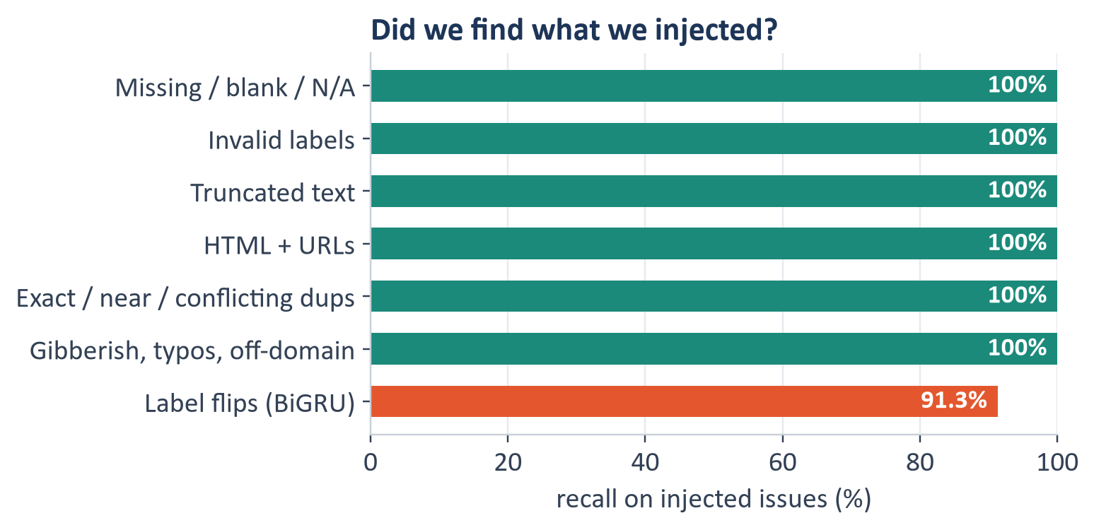
RECOMMENDER
Background
Data
BiGRU
Detectors
Recommender
Agent
Wrap-up
Benchmark results: what the system found
Recall per injected issue, and how precise the two deep learning detectors are
Detector | Flagged | Recall | Precision | ROC-AUC
Rule checks (10 issue types) |  | 100% | exact rules
BiGRU label auditor | 762 | 91.3% | 50% flips, 66% any | 0.975
Autoencoder alone | 381 | 79% junk | 79% junk, 82% any | 0.983
Autoencoder + OOV > 30% |  | 100% junk
Most auditor flags that are not injected are real: e.g. a Boston archbishop story labelled Sports, the Sprint and Nextel merger labelled Sci/Tech.
86.1 → 98.8
1.1%
5.5%
261 (3.4%)
benchmark score after applying the plan
autoencoder false alarms on untouched rows
clean rows lost by the drop-based cleaner
suspect labels in the real AG News test set
DQ-Recommender · AASD 4014 Deep Learning I
⌂ Home
19/25

Slide 20


AGENT
Background
Data
BiGRU
Detectors
Recommender
Agent
Wrap-up
Preprocessing agent: state, actions and policy
A tool-using loop over the recommender's issues (dq/agent.py)
State (observe)
Action library (applied in this order) | Targets issue | Kind
Standardise disguised missing ('N/A', blanks → NaN) | disguised_missing | repair
Drop empty-text rows / invalid or missing labels | empty_text, invalid_labels | drop
Impute text from the other field; numeric median | missing_<col> | repair
Repair encodings and markup | artifacts_* | repair
Resolve conflicting labels by majority vote | label_conflict | drop
Remove exact, normalised and near duplicates | dup_rows, near_dup | drop
Remove junk rows (autoencoder + OOV > 30%) | anomalies, high_oov | drop
Remove truncated texts | very_short | drop
Fix mislabels: relabel if p ≥ 0.90, else drop | label_noise | drop
Tabular: drop ID/constant cols, clip, log | outliers_*, skew_* | repair
Profile: missing, duplicates, conflicts, sparsity, outliers, balance
Issues with affected-row counts and severity
Quality score and its 5 dimensions
Model evidence: BiGRU label noise, autoencoder anomalies
Row-loss budget 20% · mislabel policy: relabel_confident (also relabel_all, drop_all, flag_only)
The loop →
DQ-Recommender · AASD 4014 Deep Learning I
⌂ Home
20/25

Slide 21

AGENT
Background
Data
BiGRU
Detectors
Recommender
Agent
Wrap-up
Agent: the observe → plan → act → verify loop
Deterministic, auditable decisions with rollback
Observe
dq/agent.py · run()
O
audit → profile, issues, score
state = audit(df) # observe
for action in LIBRARY: # plan
if state.affected(action.targets) == 0:
continue
new = action.apply(copy(df)) # act
if action.destructive and
rows_lost(new) > 0.20 * n0:
log('refused: over budget'); continue
after = audit(new) # verify
if after.score + 0.05 < state.score:
log('rolled back')
else:
df, state = new, after; log(why, effect)
advise(state) # vocab, max_len, grouped split
Verify
one action
per iteration
Plan
V
P
re-audit; keep or roll back
next action whose issue is present
Act
A
apply to a copy, check budget
← Actions
Agent results →
DQ-Recommender · AASD 4014 Deep Learning I
⌂ Home
21/25

Slide 22

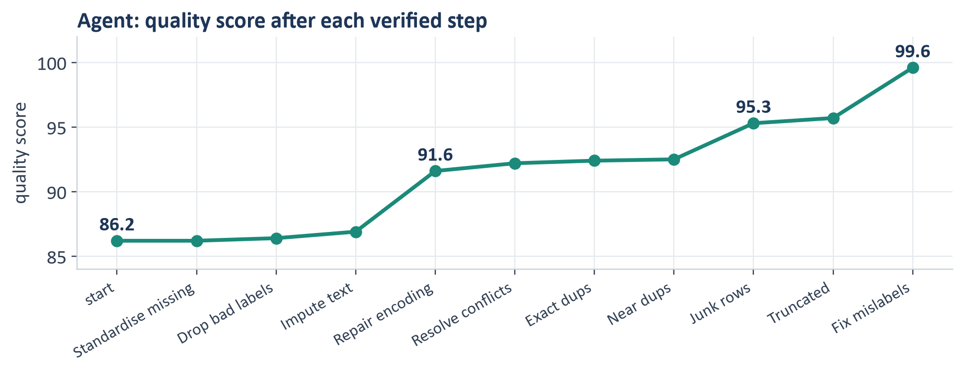
AGENT
Background
Data
BiGRU
Detectors
Recommender
Agent
Wrap-up
Agent run on the benchmark
10 actions applied, 2 pieces of advice, 0 rollbacks, 24 seconds
Biggest steps | Score
Repair encodings (4,568 cells) | +4.7
Remove junk rows (466) | +2.8
Fix mislabels (412 relabelled, 212 dropped) | +3.9
Everything else | +2.0
← How it works
86.2 → 99.6
6,785 vs 6,428
285 / 380
4.3% vs 5.5%
quality score
rows kept: agent vs fixed cleaner
label flips relabelled to the true class
clean rows lost: agent vs cleaner
Every decision is logged with what the agent saw, what it did, why it helps and the measured effect
DQ-Recommender · AASD 4014 Deep Learning I
⌂ Home
22/25

Slide 23
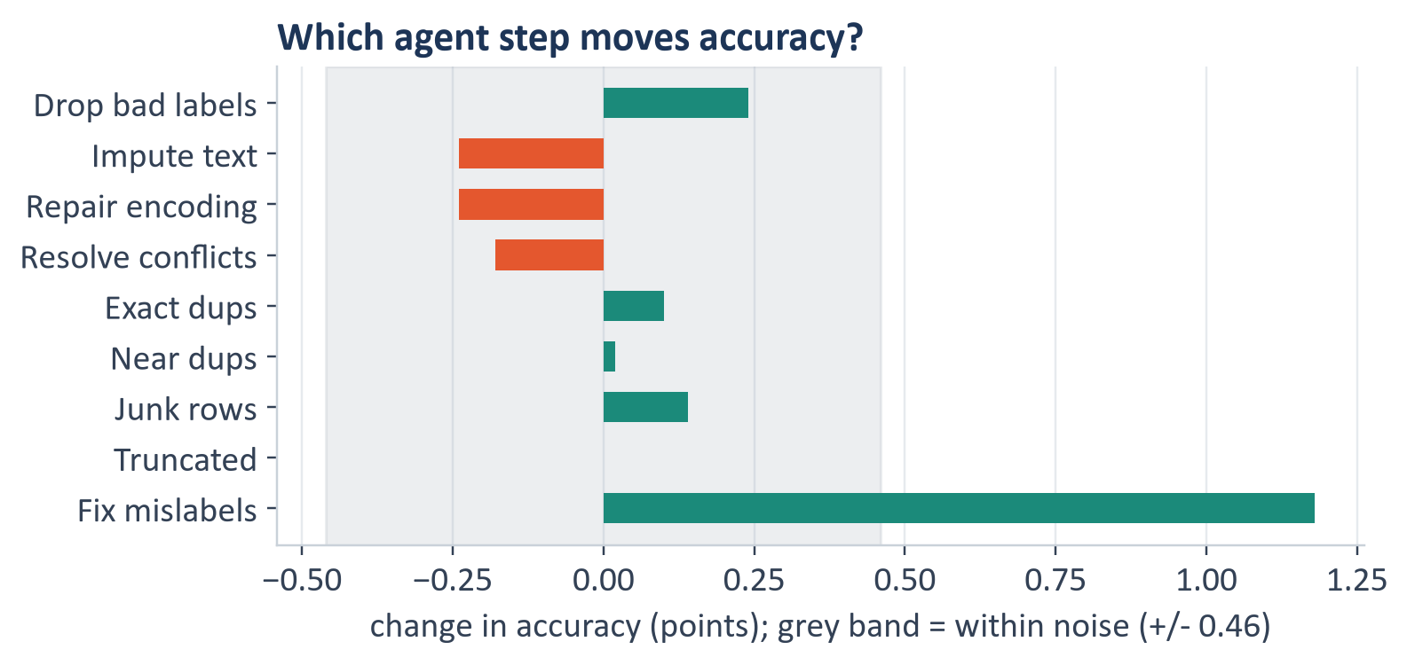
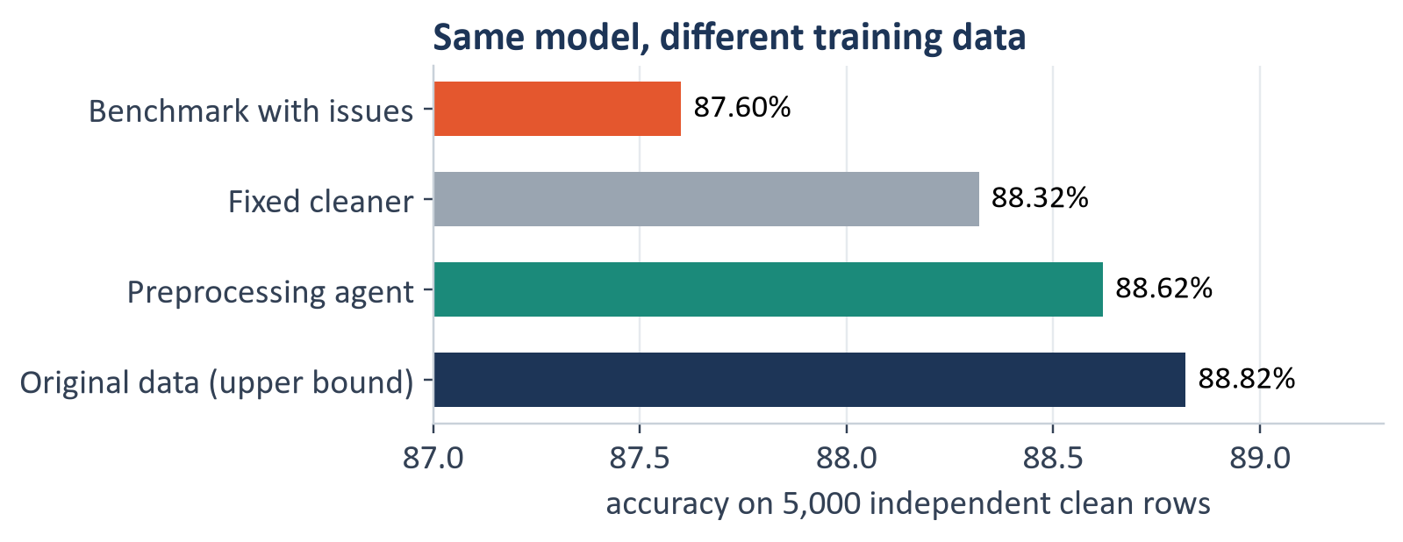
AGENT
Background
Data
BiGRU
Detectors
Recommender
Agent
Wrap-up
Does the cleaning actually help a model?
Same TF-IDF + logistic regression model, trained on each version, scored on 5,000 independent clean rows
84%
+1.18 pts
+1.02 pts
88.82%
of the accuracy lost to the issues recovered
from fixing mislabels, the only step above noise
accuracy: 87.60% dirty → 88.62% after the agent
upper bound: the original clean data
Label quality moved accuracy most; duplicate and encoding fixes make evaluation honest and the input cleaner
DQ-Recommender · AASD 4014 Deep Learning I
⌂ Home
23/25

Slide 24

WRAP-UP
Background
Data
BiGRU
Detectors
Recommender
Agent
Wrap-up
Looking back
Benchmark model, plan of attack, and what we would do differently
A
Did we have a benchmark?
B
Did the plan make sense?
C
What would we change?
Yes: TF-IDF + logistic regression, 92.32% test accuracy
It beat our BiGRU by 0.35 points; we kept the BiGRU for calibrated probabilities
For the agent, dirty (87.60%) and original (88.82%) data bracket the result
Yes, testing detectors on injected issues was the key decision
It exposed a flaw: v1 autoencoder flagged 96% of short clean texts
Retraining a model showed which agent steps really matter
Fine-tune a pretrained encoder (DistilBERT) for accuracy and calibration
Out-of-fold label auditing, so training sets can be audited without bias
Let the agent pick drop, relabel or impute by measured downstream gain
Lesson: evaluate the detector, not just the model, and measure preprocessing by its effect on a model
DQ-Recommender · AASD 4014 Deep Learning I
⌂ Home
24/25

Slide 25

WRAP-UP
Conclusions and live demo
Problem solved
Wrong labels, junk rows and rule-level issues are found automatically, with severity, a score and an ordered plan
Live demo (Streamlit)
Load the benchmark with injected issues
Walk the report: score, issues, code
Run the agent and read its step cards
Download the cleaned CSV and preprocess.py
Models
BiGRU 91.97% test accuracy with a contained mild overfit; calibrated autoencoder flags non-news text with 1.1% false alarms
Real impact
The agent lifts the score 86.2 → 99.6 and recovers 84% of lost model accuracy; 3.4% of real AG News test rows look mislabelled
Next steps
Pretrained encoder, label checks for any domain, learned severities, monitoring of incoming batches
streamlit run app.py → localhost:8501
Thank you. Questions?
⌂ Home

